Slide 1
Cafe Management System

Slide 2
Fields in Billing App
Buttons:
Total
Reset
Receipt
Exit

Slide 3
Functionality:
Procedure To Use App :
First, we must give how many quantities we need on products.
Then we need to click on the Check box
Then it will automatically add in the Cost of products.
If the user tries before all step the total and Receipt buttons

Slide 4
Summary
The topic of my project is the Café Management System which contains all types of calculations for billing. It is a tool for vendor-slid billing. A Lis of the Cafe Drinks and Cake types is also in the Front View.
After Entering the quantity we must have to enable the check box for that product
Then it will automatically get added to our count.
The Bill will provide in the text area, for the user’s understanding.
All bills contain unique random numbers for reference.
Finally, there are four buttons: total, receipt, reset bill, and exit.

Slide 5
Tools used:
Apache NetBeans
Core language
java

Slide 6
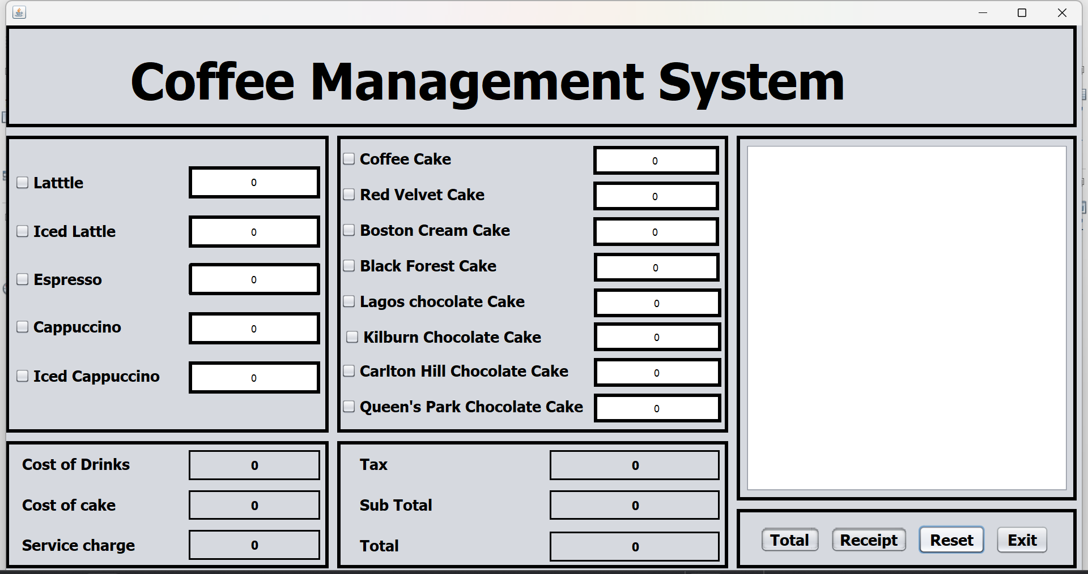
Front View Of Billing App

Slide 7
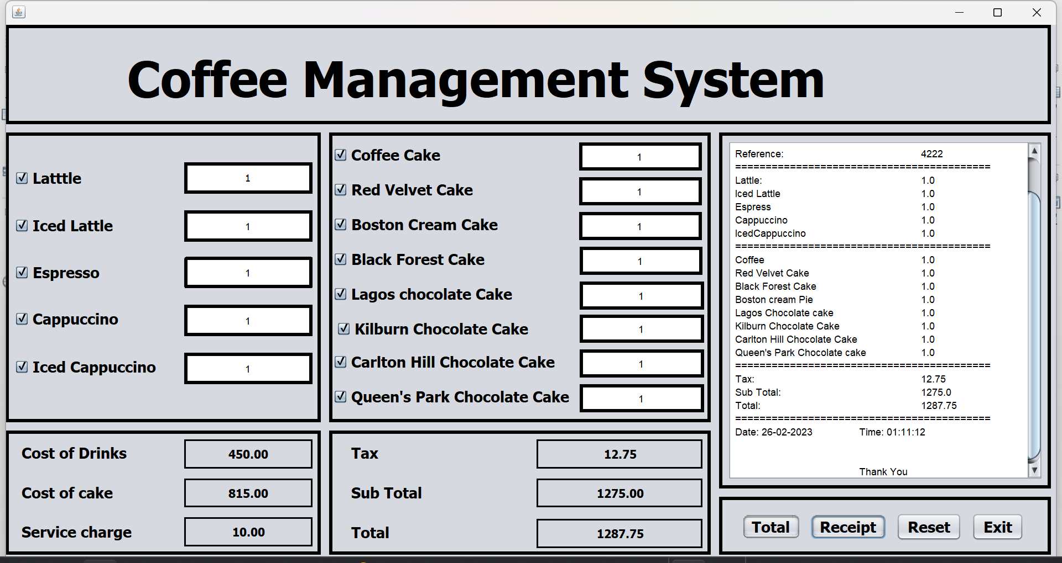
After Giving Data Front view:

Slide 8
Thank you

